Slide 1
ANZ Bank Transaction Data Analysis
EDA of Customer transaction data using Python
[Client’s Name][Data Analytics Team]

Slide 2
Index
Data Description
The Data
Data Features
Problem Statement
Customer Location
Data Visualization
Data Findings

Slide 3
Data Description
The Dataset given to us is a synthesized transaction dataset by ANZ.
The dataset contains 3 months worth of data from August 2018 to September 2018 about a 100 hypothetical customers.
The dataset has about 12043 transactions with 23 different features about each transaction like the transaction, customer id, merchant state etc.
The dataset includes details about the customer account, customer and merchant locations and transactions.
Our main aim here is to explore the dataset and to find any interesting insights that may interest in ANZ’s management team.

Slide 4
The Data
The dataset contains 12043 transactions for 100 customers who have one bank account each. Transactional period is from 01/08/2018 - 31/10/2018 (92 days duration). The data entries are unique and have consistent formats for analysis. For each record/row, information is complete for majority of columns. Some columns contain missing data (blank or NA cells), which is likely due to the nature of transaction. (i.e.
merchants are not involved for Inter Bank transfers or Salary payments) It is also noticed that there is only 91 unique dates in the dataset, suggesting the transaction records for one day are missing (turned out to be 2018-08-16).

Slide 5
Data Features
status- It just states that the transaction is authorized or posted. card_present_flag- This suggests if the account was done via card or not. 1 if via card and 0 if not via card.
Account- Bank account number, a naming for us and a nominal type data. Currency- Which currency used, here it was AUD, which is Australian dollar.
long_lat – Longitude and latitude of the place where the transaction was made.
txn_description – The transaction description, that is what type of transaction was it.
Merchant id, Merchant code and First Name of transaction also, only give us nominal information.
The balance (indicating the bank) balance does give us some Ratio data. Similarly age and amount(Transaction amount) give us some ratio data, a lot of analysis can be done on such data.
Movement, tells us if it is a credit or debit transaction, ordinal data according to me, and similarly gender gives ordinal data of the person being male or female.

Slide 6
Problem Statement
To understand the market of the bank, we must see what the data tells us. Customer analytics will help us understand the financial spending of existing customers. An important part of customer analytics is customer segmentation. Segmentation is the grouping of customers who share certain interests, into homogenous groups.
From a business perspective, it is more efficient and easier to pitch a value proposition to a particular homogenous group. It helps us properly understand customer needs. It might depend on the region, where customers are based, their spending habits, amount of money spent and so on.
Understand the day to day proceedings of the bank from a statistical point of view will give the bank an idea of how shape their future proceedings.

Slide 7
Detailed Data Description
 | Card_Present_Flag | Merchant_Code | Balance | Age | Amount
count | 7717.0 | 883.0 | 12043.00 | 12043.00 | 12043.00
mean | 0.8 | 0.0 | 14704.20 | 30.58 | 187.93
std | 0.4 | 0.0 | 31503.72 | 10.05 | 592.60
min | 0.0 | 0.0 | 0.24 | 18.00 | 0.10
25% | 1.0 | 0.0 | 3158.58 | 22.00 | 16.00
50% | 1.0 | 0.0 | 6432.01 | 28.00 | 29.00
75% | 1.0 | 0.0 | 12465.94 | 38.00 | 53.66
max | 1.0 | 0.0 | 267128.52 | 78.00 | 8835.98
Average transaction amount is 187.93 AUD
Average balance amount is 14704.20 AUD
Average age of customer is 30.58

Slide 8
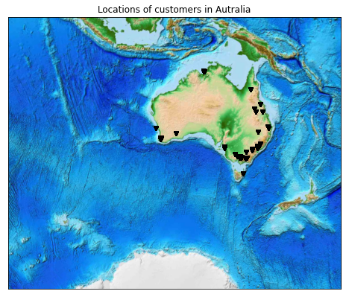
Customer Location
All the customers are from the coastline region of Australia.
Customer count – 12043.

Slide 9
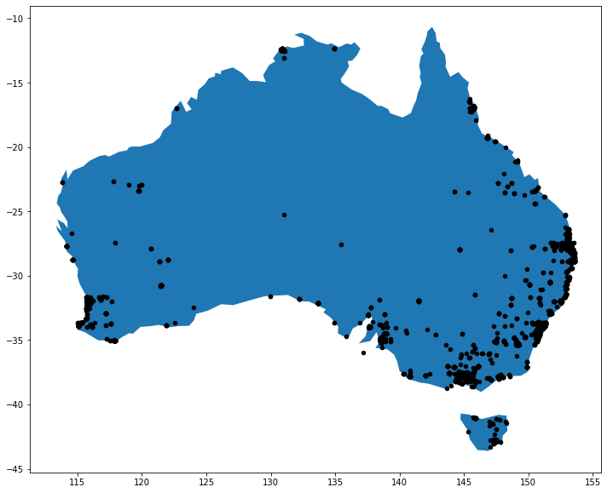
Detail Location of Customers
NSW – 2169
VIC – 2131
QLD – 1556
WA – 1100
SA – 415
NT – 205
ACT – 73
TAS – 68

Slide 10
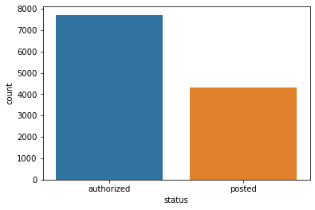
Customer Status
Authorized - 7717
Posted - 4326

Slide 11
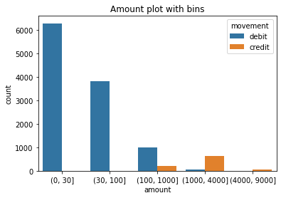
Amount range transactions
Debit - 11160
Credit - 883

Slide 12
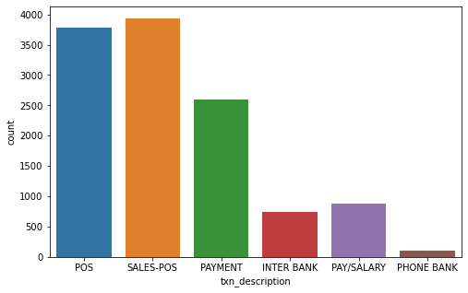
Transaction Categories

Slide 13
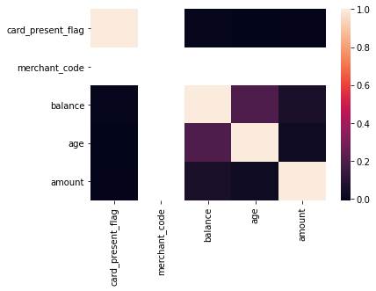
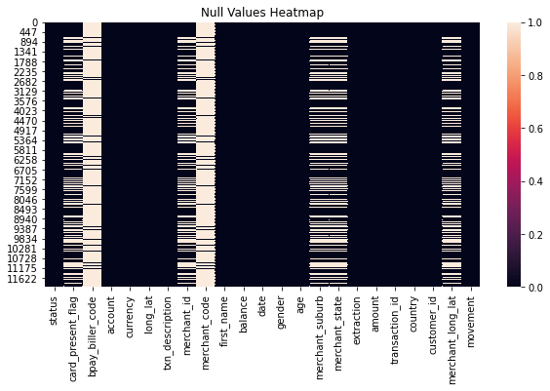
Correlation Heatmap
Non Null Values
Null Values

Slide 14
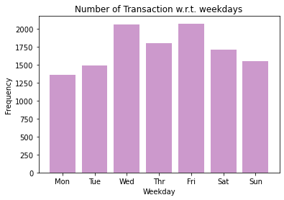
Number of Transaction w.r.t. weekdays
Maximum transaction on mid-days of week.
Wednesday and Friday showing the most while Monday the least frequency of transactions.

Slide 15
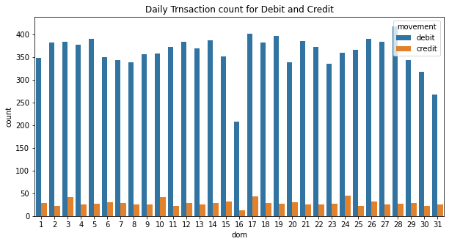
Daily Transaction count for Debit and Credit

Slide 16
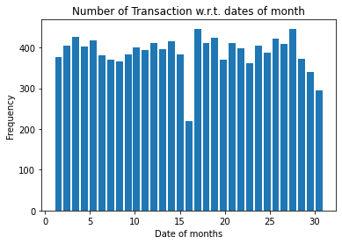
Number of Transaction w.r.t. dates of month
Less number of transaction during month's end.
Some date shows very high frequency, while some show very less frequency of transactions.

Slide 17
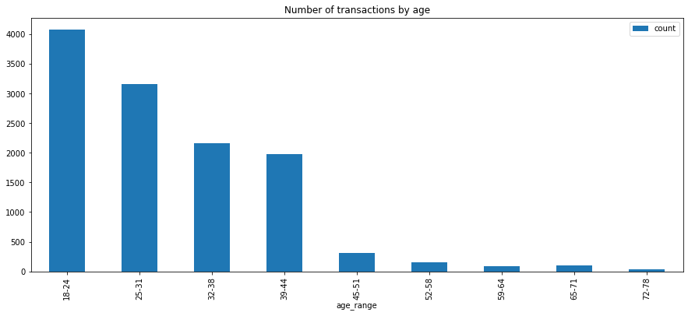
Number of Transactions by Age

Slide 18
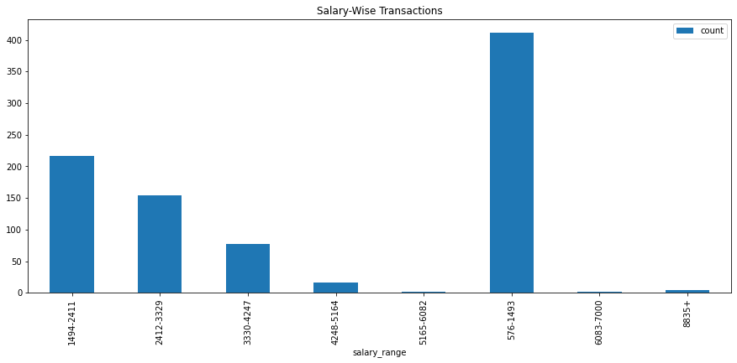
Salary-wise Transactions

Slide 19
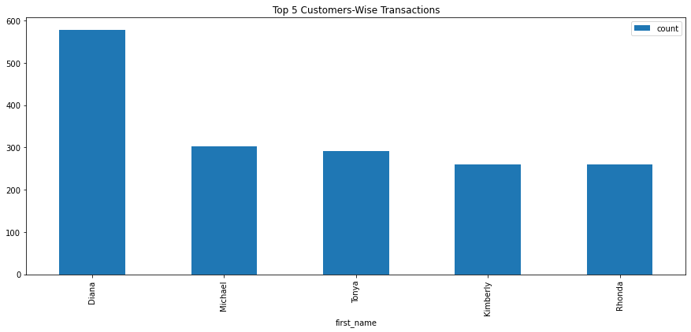
Top 5 Customers-wise Transactions
The customer Diana has shopped in QLD a number of 444 times.
The customer Michael has shopped in NSW a number of 227 times.
The customer Tonya has shopped in WA a number if 191 times.
The customer Kimberly has shopped a VIC a number of 173 times.
The customer Rhonda has shopped in QLD a number of 185 times.

Slide 20
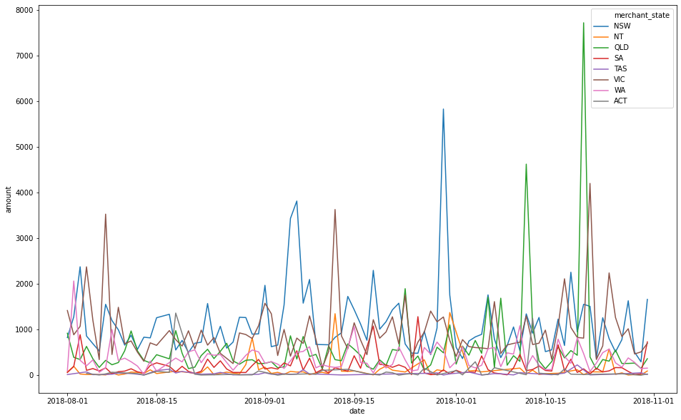
Merchant-State date and amount-wise transactions

Slide 21
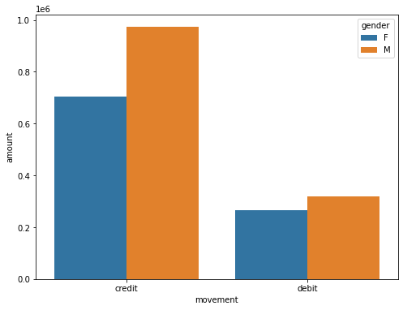
Movement wrt gender and amount

Slide 22
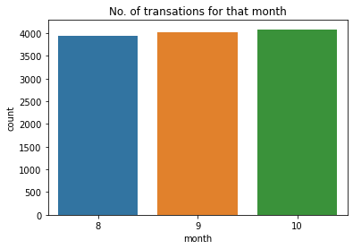
Transactions per month
Month | Number of Transactions
August | 3943
September | 4013
October | 4087

Slide 23
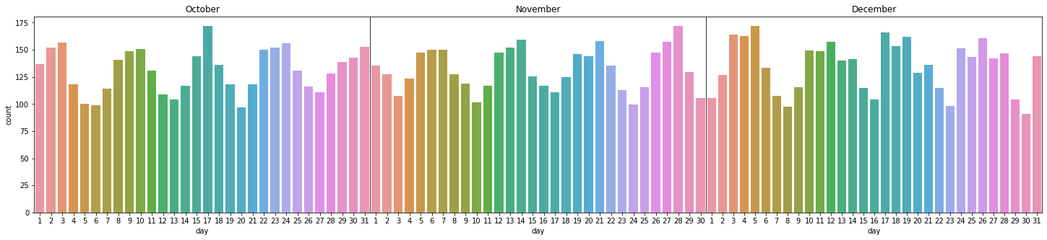
Date wise total transactions for each month

Slide 24
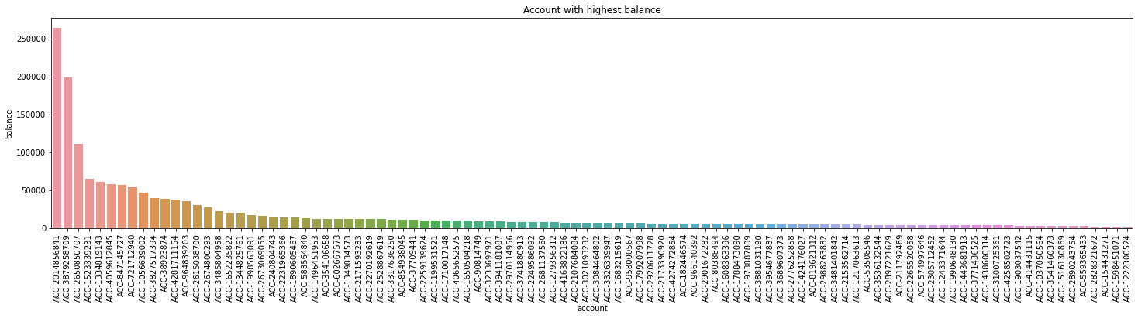
Account with balance from high to low

Slide 25
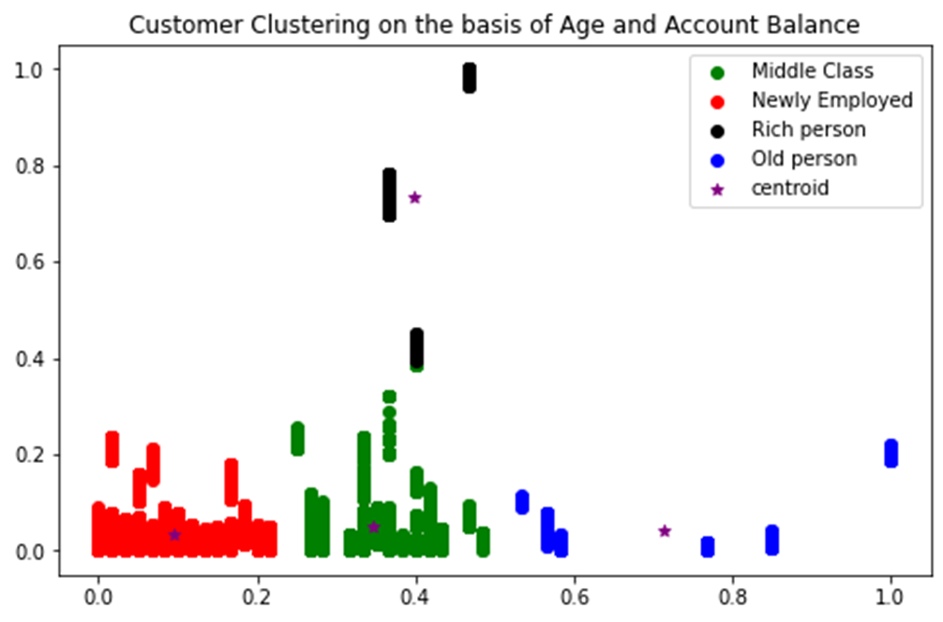
Clustering of Customers on the basis of Age and Account Balance
Cluster | No. of transactions
Newly Employed | 7226
Middle Class | 4123
Old person | 418
Rich person | 276

Slide 26
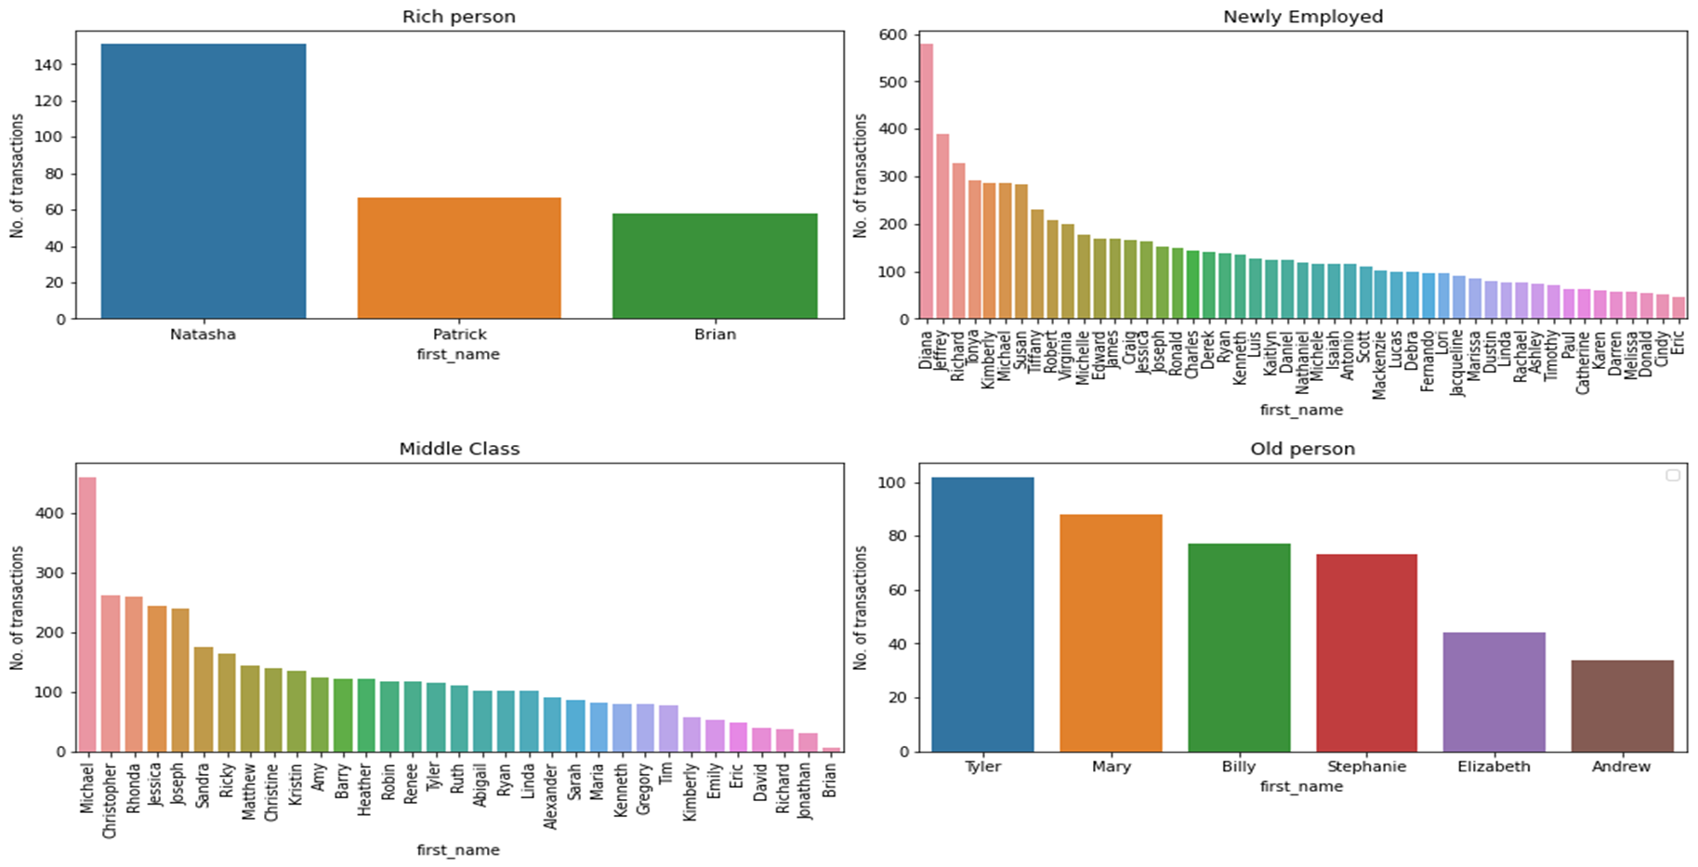
Cluster wise Customer Transactions

Slide 27
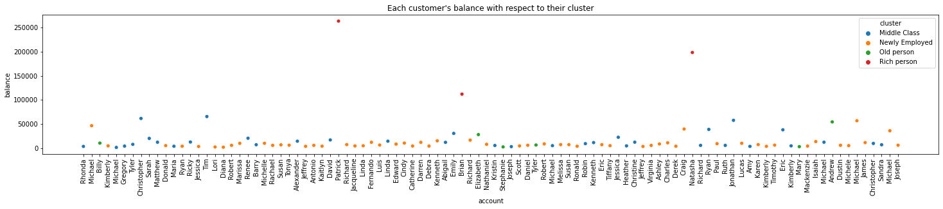
Cluster wise customer’s account balance

Slide 28
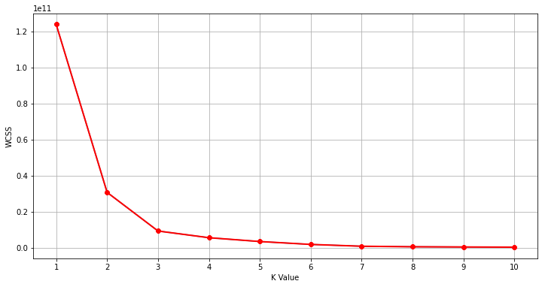
K-Means Clustering

Slide 29
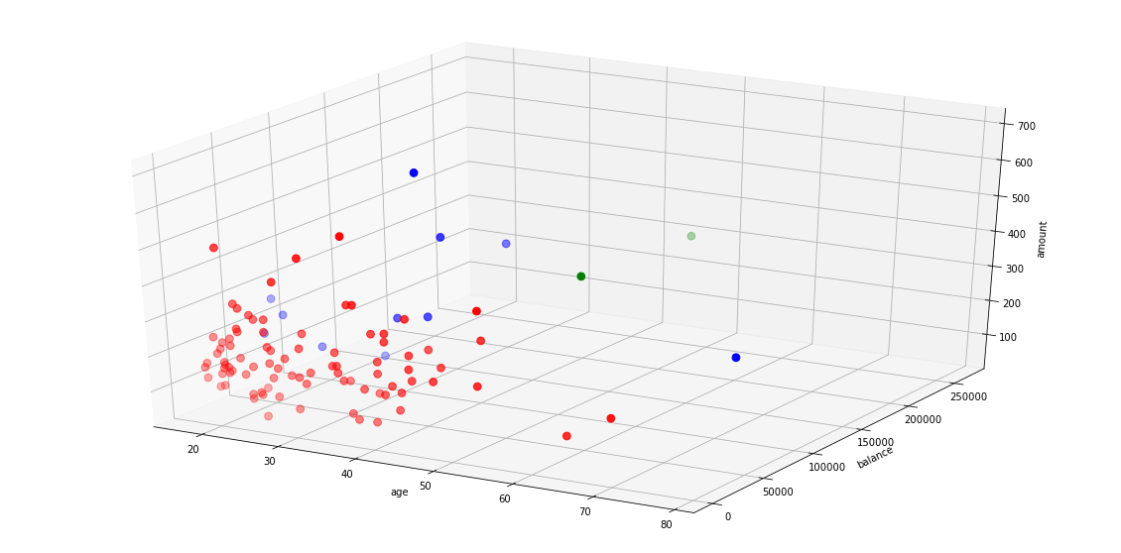
3D Segmentation

Slide 30
Data Findings [1/4]
Findings from working with data. For details of the charts and visualizations please refer to the Python NoteBook:
Total transaction volume over the dates have ranged from 10,000 to 40,000 usually, mean transactions have ranged from 100 AUD to 300 AUD usually.
Male customers have spent more on their transactions over the dates, as compared to their female customers.
States have widely distributed transaction over the dates, but New South Wales and Queensland have had a few peaks in transaction amounts.
State-wise, New South Wales, Victoria and Queensland have had most transaction. The fact that most economic centers and large cities of Australia are in this states also supports the fact.
Going by total transaction in sub-regions maximum transactions have come from Sydney, Melbourne and
Brisbane. These are the largest cities in Australia, and it is logical that largest transactions come from there.
Going by mean transactions in sub-regions high values have been from Pantapin, Gladesville, Parap and such. But it seems these places have had very few transactions. So we cannot yet determine much about them.
Total values of sum of customers bank accounts balance have been in the range of 1000000 to 1500000 AUD over the dates.
The mean and usual account balance of the customers has varied from 10,000 to 20,000 AUD over the times. This does suggest that customers have been saving money, and their assets have grown.

Slide 31
Data Findings [2/4]
Male customers have had a higher account balance than female customers, over the dates.
The mean transaction bar plot shows that the value has remained fairy uniform over the ages, except for a few dips at 24,37 and rises at 35,42 and 52. But, one a similar note, the total transaction has high rises for 22 and 34. It might mean there are many customers in the bank for that age.
Most of the customers of the bank have made more credit transactions, as compared to debit transactions.
Working with the map coordinates, it becomes clear that the majority of the transactions are based where the major cities of Australia are.
Making a wordcloud of customer first name based on Transaction mean amount gives us the names having most spending are- Jonathan, Brian, Melissa, Kenneth, Cindy etc.
I also do a bit of customer segmentation. I worked more of that on Task 2. Task 2 report will have more detailed analysis.
The key takeaways we can get is that, most spending is coming from the large cities of Australia and from some key states. The bank should look to expand its operations in these areas.
Some customers also have tendency to spend more than others. Apart from that, the average bank balance of the customers have increased. It indicates that the bank customers are getting well financially.

Slide 32
Data Findings [3/4]
There are some areas with low transaction rate : ACT, TAS, NT, SA
Active range of age of customers doing transaction is between 18-31.
All the salaried people are from Melbourne who are doing transactions.
Male salaried people are more than female salaried people.
Salaried person between age range 18 to 24 are more active in making transactions.
Highest number of transactions are done by person with salary range in between 576-1493 AUD.
Top 5 customers in making transactions are : Diana, Michael, Tonya, Kimberly and Rhonda
Most active customer among top 5 customers is Diana followed by Michael, Tonya.
Number of Transactions per month : 4014
Amount of Transaction per month : 754422.65 AUD
Maximum number of the transactions are done by customer with account number ACC-1598451071 followed by customers with account number ACC-1222300524, ACC-182446574, ACC-4258502723.
Maximum amount of transactions done by customer with account number ACC-3317636250 followed by customers with account number ACC-1496451953, ACC-1523339231, ACC-2231965366, ACC-240804743.
Number of transactions per customer : 120

Slide 33
Data Findings [4/4]
Amount of transaction per customer : 22632.68 AUD
Number of transactions per week : 1720
Amount of transaction per week : 323323.99 AUD
Most of the transactions are done on 28 sept 2018 followed by dates 17 august 2018 and 5 october 2018.
Maximum number of transactions are authorized.
Maximum number of transactions are SALE POSE transactions.
Gender distribution is nearly same but there are little more transactions by male customers.
Maximum number of transactions are done for debit.
Maximum number of transactions are done on Friday followed by Wednesday.
Balance amount of customers lie mostly below 25000 AUD.
October month has maximum number of transactions.
Maximum number of transactions are done on weekends.

Slide 34
Thank you ☺

